Slide 1
Transport Layer Protocols
Dr. Geetha V
Asst Professor,
Dept of IT,
NITK, Surathkal

Slide 2
Index
Introduction
TCP Header Format
TCP Flow Control
TCP State Diagram
Congestion control
Slow start
Congestion avoidance
Fast Recovery and Retransmit

Slide 3
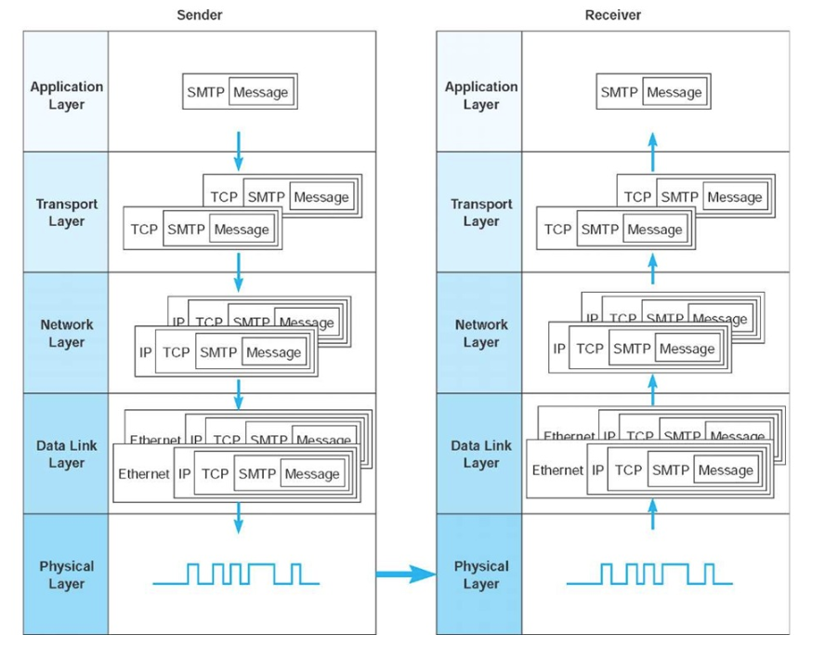
Message Transmission using Layers [1]

Slide 4
Functions of Transport Layer
Guarantees message delivery
Delivers messages in the same order they are sent
Delivers at most one copy of each message
Supports arbitrarily large messages
Supports synchronization between the sender and receiver
Allows the receiver to apply flow control to the sender
Supports multiple application processes on each host

Slide 5
Limitations of Network Layer
Drop messages : Due to link failure or buffer full
Reorder messages: Due to packets may travel in different path
Deliver Duplicate copies: Due to timeout
Limit messages to some finite size: Due to network limitation
Deliver messages after an arbitrarily long delay: due to delay in path or queue

Slide 6
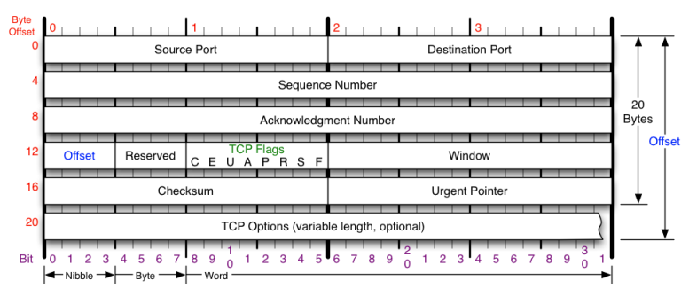
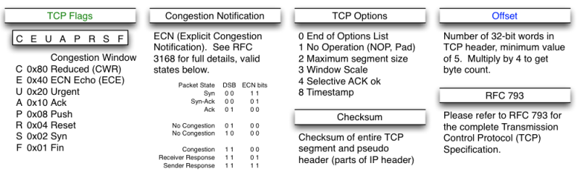
TCP Header Format

Slide 7
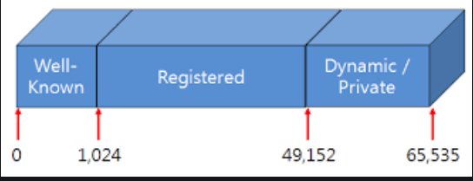
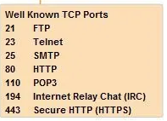

TCP Header
Total data bytes:
65,535-20-20=65,515 bytes (TCP Header 20 and IP header 20)
Source and Destination Port:

Slide 8
TCP Header
Sequence Number (x) and Acknowledgement Number (x+1) :- Indicates the next byte to be received.
32 bit => its numbers are based on number of bytes
Example: explain

Slide 9
TCP Header
Offset/TCP header length (no. of words) : number of 32 bit words in header
5 words => 5 x 4 = 20 bytes (without Options)
Options:
U: URG: Urgent Pointer: U=1 Urgent pointer is valid
A: ACK: A=1 Acknowledgment is Valid
P: PSH: P=1: Push data to application upon arrival
R: RST: R=1 Reset the connection
S: SYN S=1 and A=0: Establish Connection
F: FIN F=1: Release a connection

Slide 10
TCP Header
Window Size:
Sliding window flow control
How many bytes may be sent starting at the byte acknowledged
Synchronization ( 3 way handshake between sender and receiver)
Window size advertisement (example)
Nagle’s Algorithm: Send one byte from sender and buffer other bytes till it receives ACK
Issue - Low bandwidth utilization
Silly Window syndrome : Sending large blocks from sender and receiver, buffer is full and ACK for every byte getting free.
Issue – Every byte extra header overhead (TCP and IP)
Clark’ s Solution: Receiver must wait and advertise only when sufficient buffer space is available
Issue: Sender must wait and it may increase response time.

Slide 11
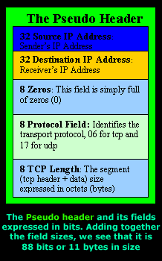
TCP Header
Checksum
To ensure reliability
Checksum is calculated with set of 16 bit words
Initial value for checksum is 0’s
Calculate checksum including Pseudo header +TCP header and Payload
Sender side: Algorithm: add all 16 bit words 1’s complement
Checksum is 1’s complement of the sum
Receiver side: calculate checksum: if the result is zero accept the segment.

Slide 12
TCP Header
Pseudo header
Source address= 198.35.65.5
Destination address: 199.27.46.9
Reserved: 0x00 Protocol: 0x06 (tcp) TCP length: 20 0x14
TCP header
Source Port number = 80 0x50 | Destination Port number=80 0x50
Sequence number = 512 0x200
Acknowledgement = 1024 0x400
Offset=5 Res =0 flags: U A P R S F | Window Size = 1024 0x400
Checksum = 0x00 (Initialization) | Urgent Pointer=0x00

Slide 13
TCP Header
Pseudo header in bits
Source address= 11000110.00100011.01000001.00000101
Destination address: 11000111.00011011.00101110.00001001
Reserved: 0000 0000 Protocol: 0000 0110 TCP length: 0001 0100 pad: 0000 0000
TCP header in bits
Source Port = 0000 0000 0101 0000 | Destination Port = 0000 0000 0101 0000
Sequence number = 0000 0000 0000 0000 0000 0010 0000 0000
Acknowledgement = 0000 0000 0000 0000 0000 0100 0000 0000
Offset=0101 flags: 0000 0001 0000 |  | Window Size =0000 0100 0000 0000
Checksum =0000 0000 0000 0000 |  | Urgent Pointer= 0000 0000 0000 0000

Slide 14
TCP Header Checksum
1100 0110 0010 0011
0100 0001 0000 0101
1100 0111 0001 1011
0010 1110 0000 1001
0000 0000 0000 0110
0001 0100 0000 0000
0000 0000 0101 0000
0000 0000 0101 0000
0000 0000 0000 0000
0000 0010 0000 0000
0000 0000 0000 0000
0000 0100 0000 0000
0101 0000 0001 0000
0000 0100 0000 0000
0000 0000 0000 0000
0000 0000 0000 0000
Sum= 0110 1011 0000 0100
Take 1s complement of sum
0110 1011 0000 0100
That is
1001 0100 1111 1011
So check sum is
1001 0100 1111 1011

Slide 15
TCP Header
Pseudo header in bits
Source address= 11000110.00100011.01000001.00000101
Destination address: 11000111.00011011.00101110.00001001
Reserved: 0000 0000 Protocol: 0000 0110 TCP length: 0010 1000 pad: 0000 0000
TCP header in bits
Source Port = 0000 0000 0101 0000 | Destination Port = 0000 0000 0101 0000
Sequence number = 0000 0000 0000 0000 0000 0010 0000 0000
Acknowledgement = 0000 0000 0000 0000 0000 0100 0000 0000
Offset=0101 flags: 0000 0001 0000 |  | Window Size =0000 0100 0000 0000
Checksum =1001 0100 1111 1011 |  | Urgent Pointer= 0000 0000 0000 0000

Slide 16
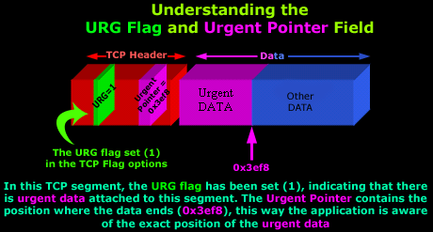
TCP Header
Urgent Pointer:
eg: Upload of large data and TELNET working simultaneously
Portion of data requested by receiver as urgent

Slide 17
Synchronization
Sender
Receiver
SYN_SENT
SYN
SYN_REVD
SYN +ACK
ESTABLISHED
ACK
ESTABLISHED
Data transfer state

Slide 18
Starting Point
CLOSED
1
Timeout
Send: RST
Appl: passive open
Send: Nothing
Appl: active open
Send: SYN
Recv:SYN;
Send: SYN,ACK
5
LISTEN
Appl: send data
Send: SYN
2
Passive Open
Appl: close
Or timeout
3
Recv: RST
SYN_RECD
recv: SYN
Send: SYN,ACK
Simultaneous Open
SYN_SENT
4
Active Open
recv: ACK
Send: <nothing>
6
Recv:SYN,ACK
Send:ACK
7
ESTABLISHED
https://www.tangentsoft.net/wskfaq/articles/debugging-tcp.html

Slide 19
Closing Connection 1

Slide 20
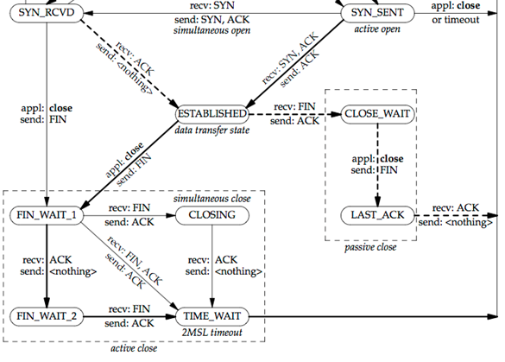
1
3
2
7
4
8
9
5
6
MSL: Maximum Segment Lifetime is the time a TCP segment can exist in the internetwork system. (approx 2 min)

Slide 21
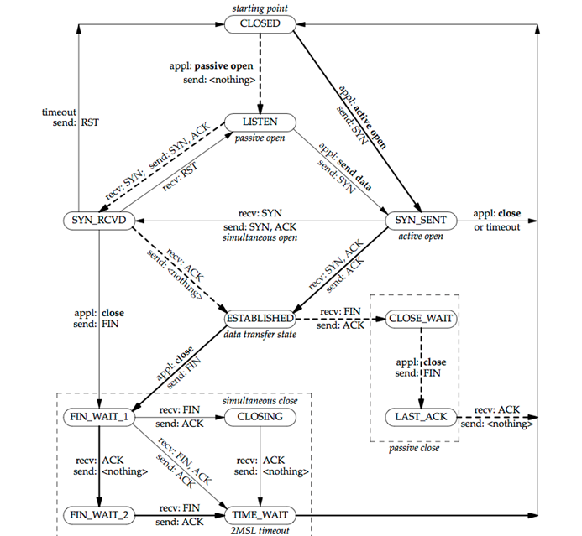

Slide 22
UDP Header Format
0
15
16
31
Source Port | Destination Port
UDP Length | UDP Checksum
Data Payload
Connectionless transport protocol
UDP length (Header + Data)in bytes
Checksum is similar to TCP (Pseudo header + UDP header+ Data)

Slide 23
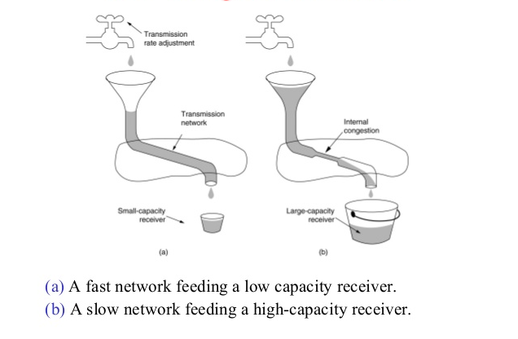
Congestion Control in Transport Layer
Identify receive capacity and network capacity
Sender sets Min(Receiver window, congestion window) in bytes

Slide 24
Congestion Control in Transport Layer
Congestion Detection
Using the Occurrences of two events
Timeout (RTO: Retransmission TimeOut)with no ACK : Sender goes for backoff
Receiving three duplicate ACKs
Congestion Policies Algorithm
Slow Start
Congestion Avoidance
Fast Recovery

Slide 25
Congestion Control in Transport Layer
Congestion Detection based on Timeout
Due to noise on transmission
Packet discard at a congested router

Slide 26
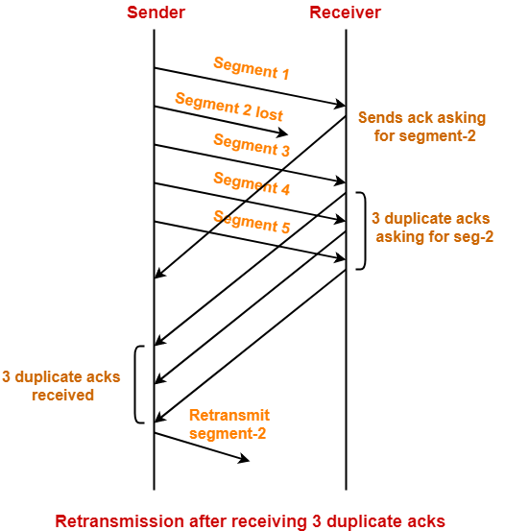
Congestion Control in Transport Layer
Congestion Detection based Three duplicate ACK

Slide 27
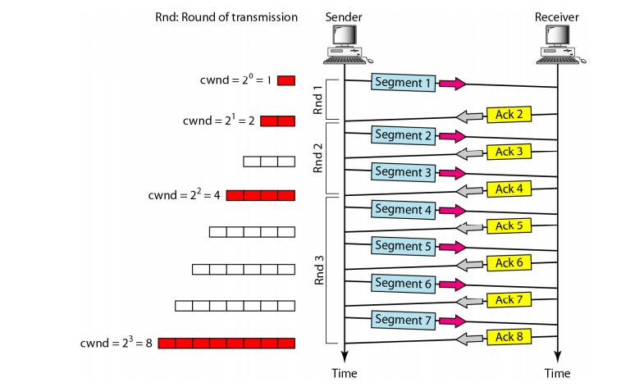
Congestion Control in Transport Layer
Congestion Policies Algorithm : Slow Start
Size of Congestion window increases exponentially until it reaches a threshold

Slide 28
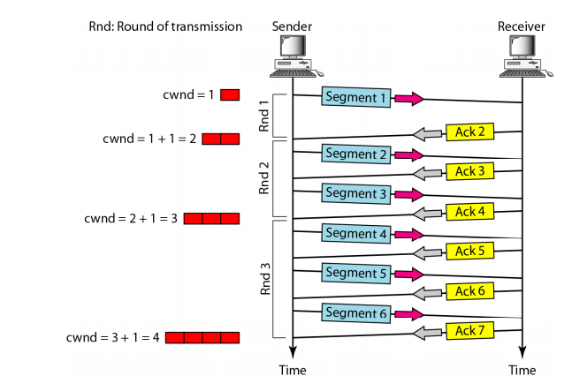
Congestion Control in Transport Layer
Congestion Policies Algorithm : Congestion Avoidance : Additive increase

Slide 29
Congestion Control in Transport Layer
Congestion Policies Algorithm : Congestion Avoidance : Additive increase

Slide 30
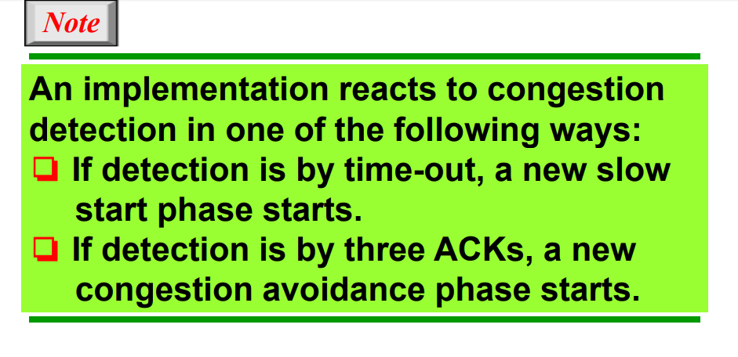
Congestion Control in Transport Layer

Slide 31
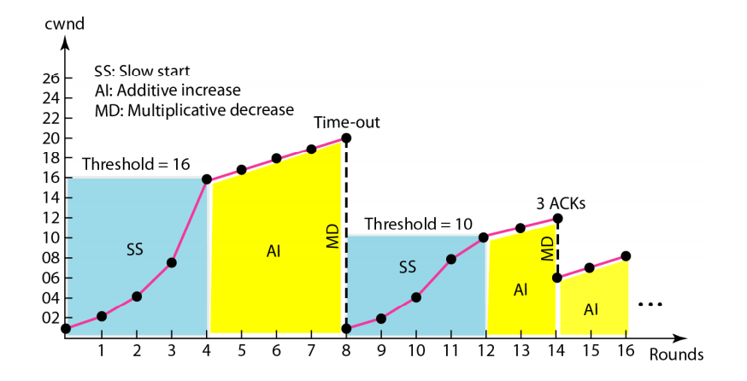
Congestion Control in Transport Layer

Slide 32
Congestion Control in Transport Layer
Slowstart
Introduced by Van Jacobson in 1989.
MSS: Maximum Segment Size in Bytes
Initialize CWND = MSS
For each ACKed Segment, CWND is increased by 1 MSS
Slowstart: Window size grows exponentially
CWND = 1 Send 1 segment Recv ACK
CWND=2 send 2 segment Recv ACK
CWND=4 send 4 segment RECV ACK
Up to the point it reaches threshold.

Slide 33
Congestion Control in Transport Layer
Congestion Avoidance Phase.
Slowstart will increase CWND size exponentially until threshold value is reached
To avoid congestion additive increase is used
CWND = CWND+1 Send CWND segment Recv ACK
CWND = CWND+1 Send CWND segment Recv ACK
CWND = CWND+1 Send CWND segment Recv ACK
Up to the point it gets either timeout or receives 3 duplicate ACKS

Slide 34
Congestion Control in Transport Layer
Congestion Avoidance Phase.
CWND = CWND+1 Send CWND segment Recv ACK
Up to the point it gets either timeout or receives 3 duplicate ACKS
If Timeout then
Threshold = CWND/2 and new CWND=1 MSS slow start phase
If 3 DUPLICATE ACK then
Threshold = CWND/2 and new CWND=CWND/2 MSS additive increase phase

Slide 35
Congestion Control in Transport Layer
Fast Retransmit and Fast Recovery
Van Jacobson introduced this modification to the congestion avoidance algorithm in 1990
Cause of duplicate ACK could be
Lost segment, or
Reordering of segments
But data is still flowing between the two ends
If three or more duplicate ACKs are received in a row
Retransmit immediately (before Timeout)- Fast Retransmit
DO congestion avoidance (NOT slow start) – Fast Recovery

Slide 36
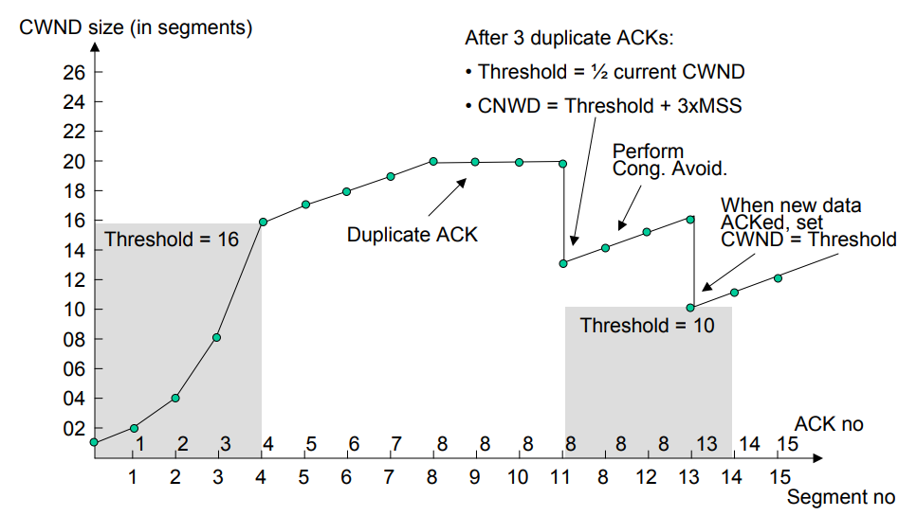
Congestion Control in Transport Layer
Fast Retransmit and Fast Recovery

Slide 37
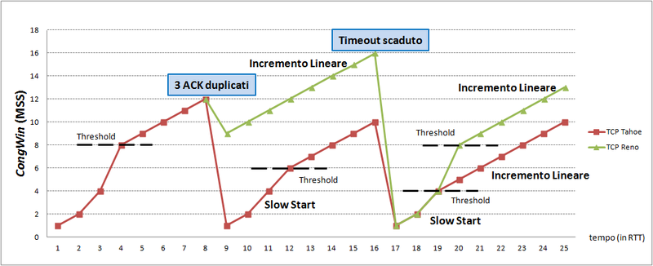
Congestion Control in Transport Layer
Comparison of TCP Tahoe and TCP Reno
https://commons.wikimedia.org/wiki/File:CongWin_in_TCP_Tahoe_e_Reno.png

Slide 38
Summary
Introduction
TCP Header Format
TCP Flow Control
TCP State Diagram
Congestion control
Slow start
Congestion avoidance
Fast Recovery and Retransmit

Slide 39
Reference
http://what-when-how.com/data-communications-and-networking/network-and-transport-layers-data-communications-and-networking/
Computer Network : Andrew S Tanenbaum
Data communication and Computer Networking: Behrouz Forouzan

